Slide 1
othello_results/baseline_games__Controller_black_vs_Corner Bot_white
baseline_games_58 Winner: Tie

Slide 2
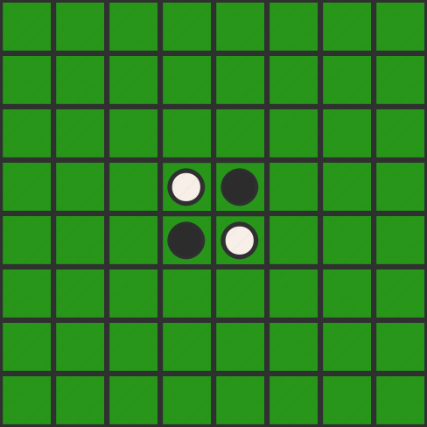
turn: 0 player: None move: None

Slide 3
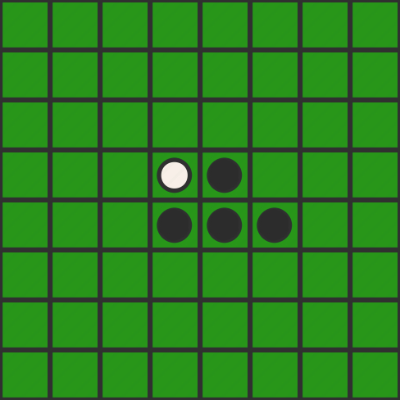
turn: 1 player: Black move: 56

Slide 4
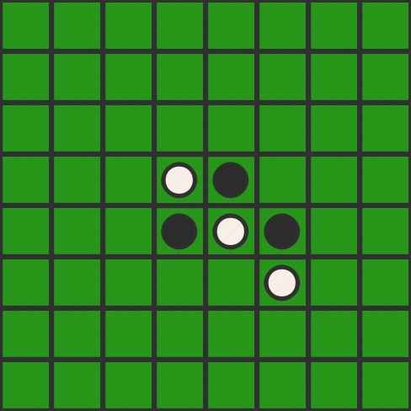
turn: 2 player: White move: 66

Slide 5
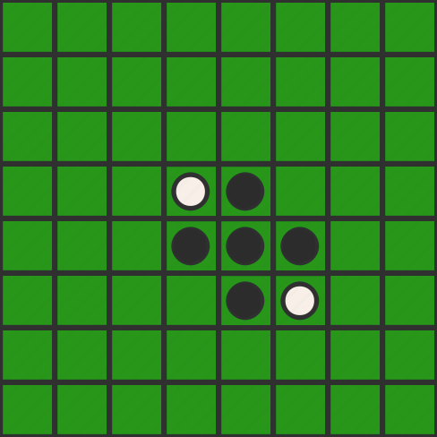
turn: 3 player: Black move: 65

Slide 6
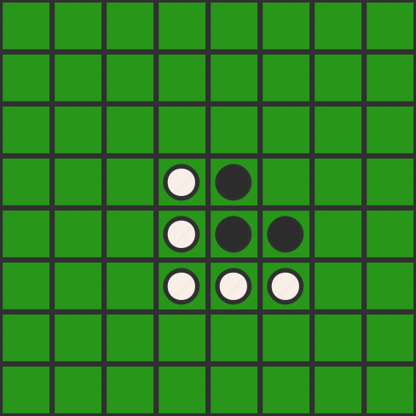
turn: 4 player: White move: 64

Slide 7
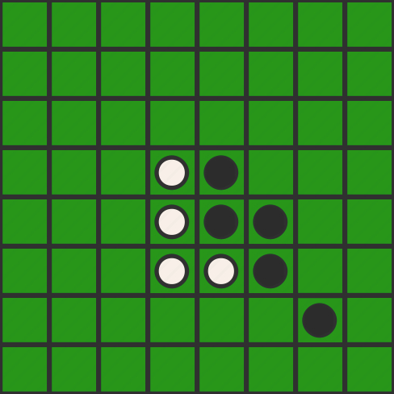
turn: 5 player: Black move: 77

Slide 8
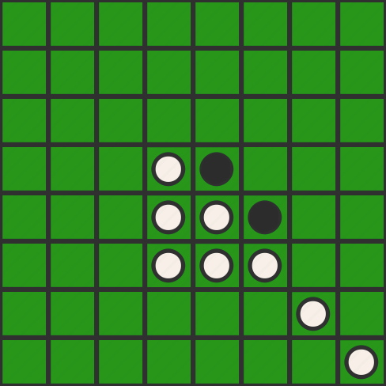
turn: 6 player: White move: 88

Slide 9
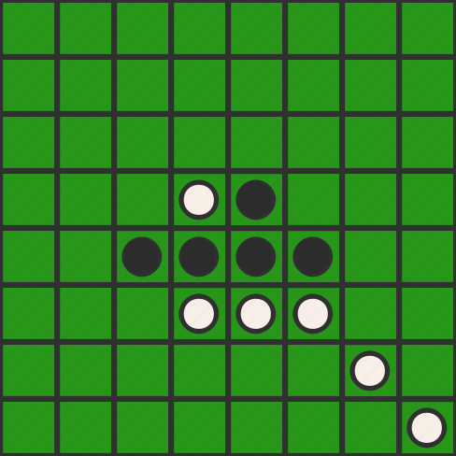
turn: 7 player: Black move: 53

Slide 10
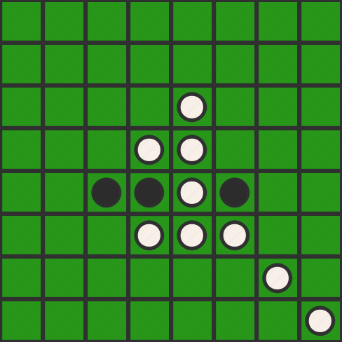
turn: 8 player: White move: 35

Slide 11
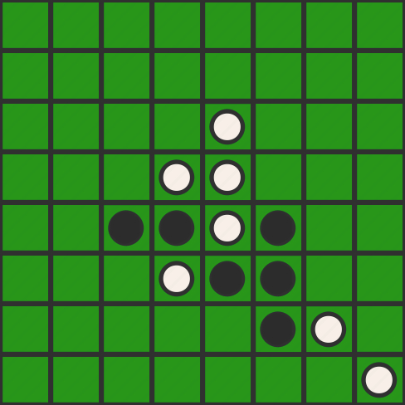
turn: 9 player: Black move: 76

Slide 12
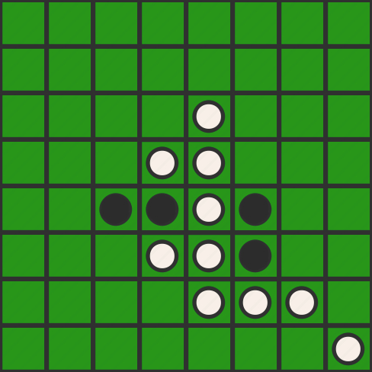
turn: 10 player: White move: 75

Slide 13
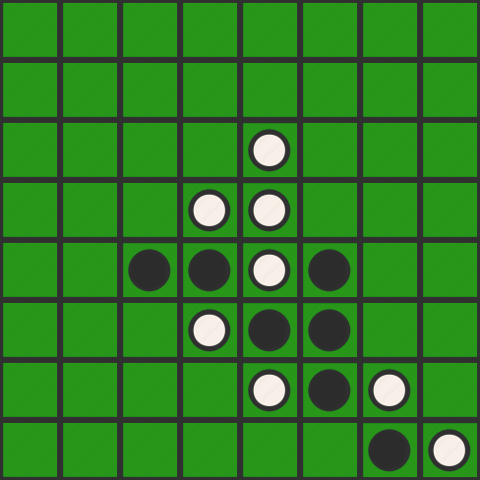
turn: 11 player: Black move: 87

Slide 14
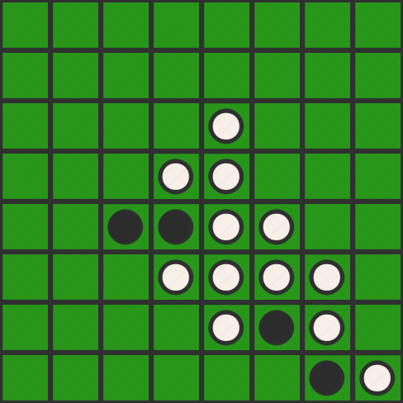
turn: 12 player: White move: 67

Slide 15
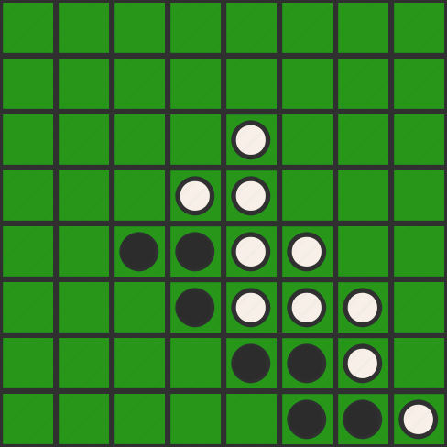
turn: 13 player: Black move: 86

Slide 16
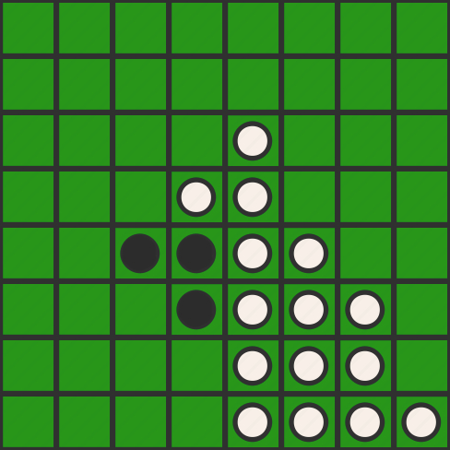
turn: 14 player: White move: 85

Slide 17
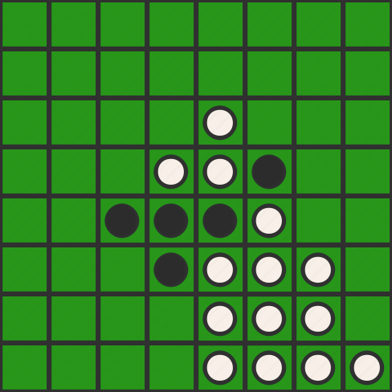
turn: 15 player: Black move: 46

Slide 18
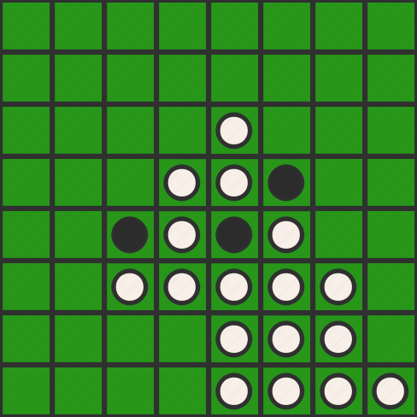
turn: 16 player: White move: 63

Slide 19
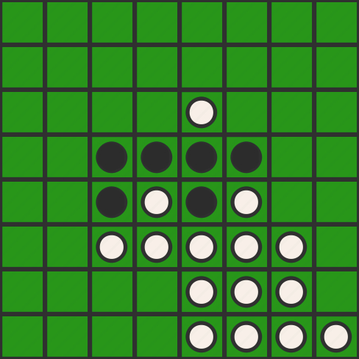
turn: 17 player: Black move: 43

Slide 20
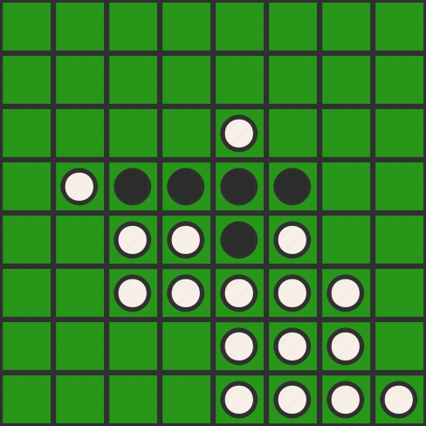
turn: 18 player: White move: 42

Slide 21
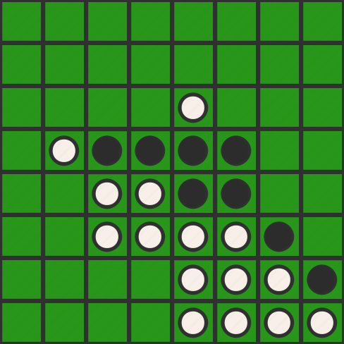
turn: 19 player: Black move: 78

Slide 22
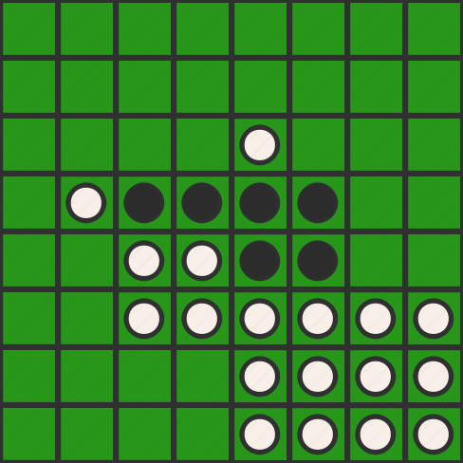
turn: 20 player: White move: 68

Slide 23
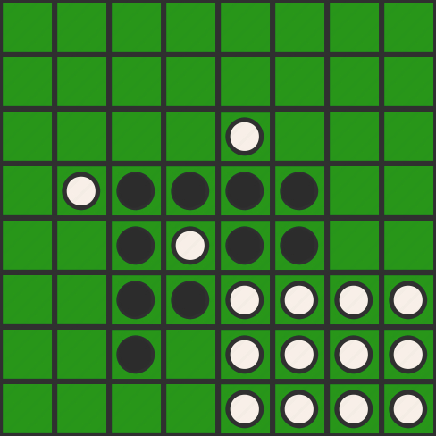
turn: 21 player: Black move: 73

Slide 24
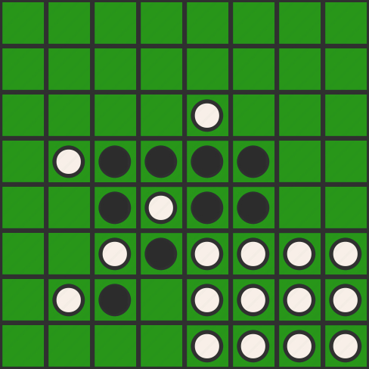
turn: 22 player: White move: 72

Slide 25
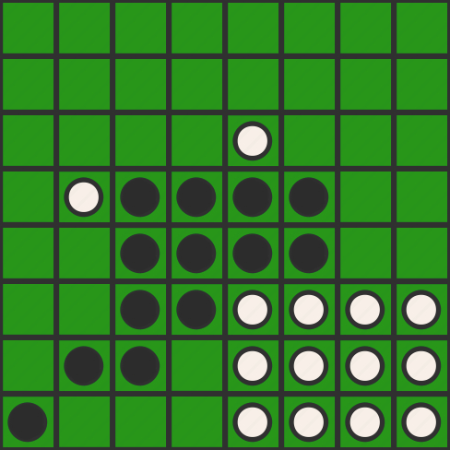
turn: 23 player: Black move: 81

Slide 26
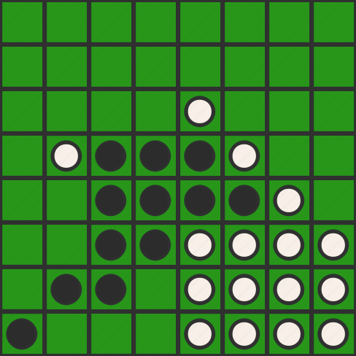
turn: 24 player: White move: 57

Slide 27
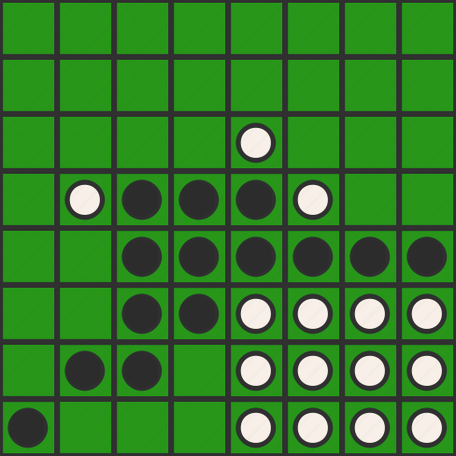
turn: 25 player: Black move: 58

Slide 28
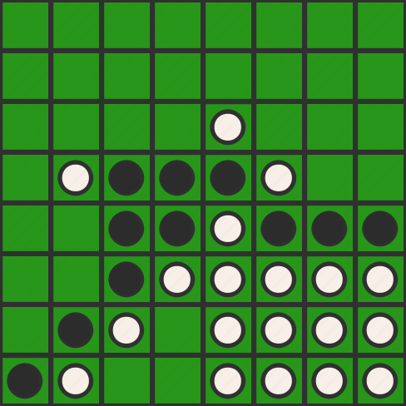
turn: 26 player: White move: 82

Slide 29
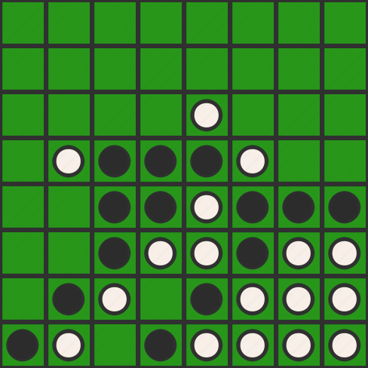
turn: 27 player: Black move: 84

Slide 30
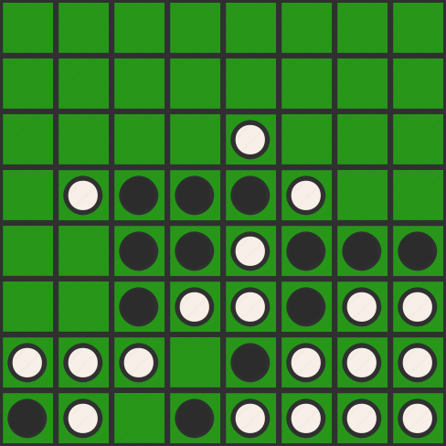
turn: 28 player: White move: 71

Slide 31
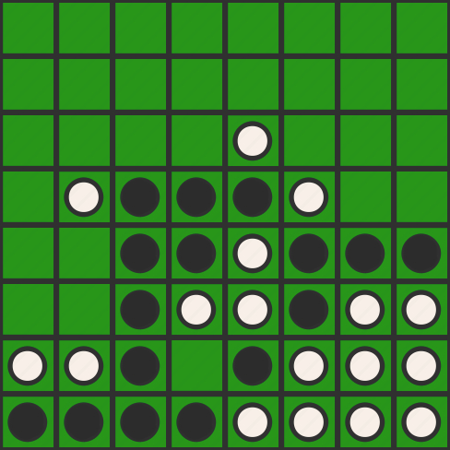
turn: 29 player: Black move: 83

Slide 32
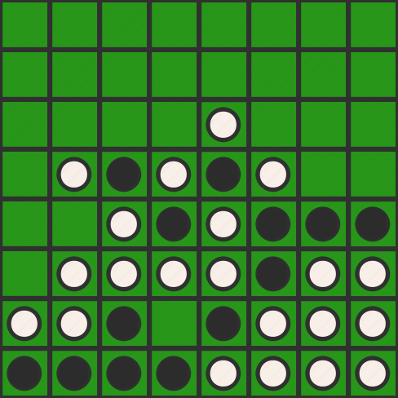
turn: 30 player: White move: 62

Slide 33
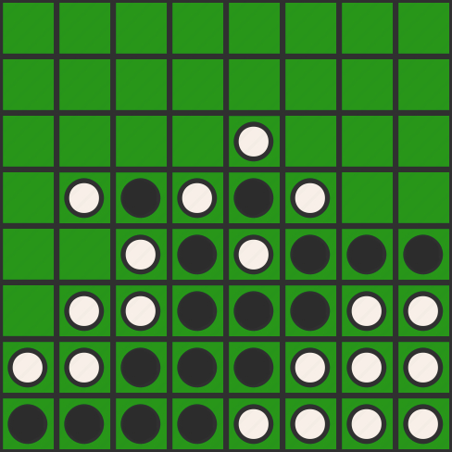
turn: 31 player: Black move: 74

Slide 34
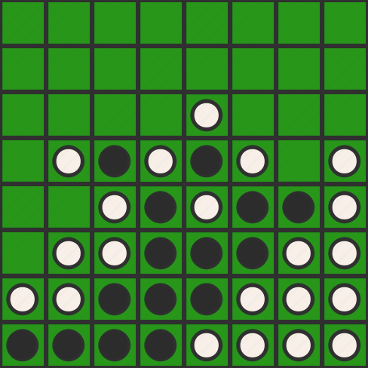
turn: 32 player: White move: 48

Slide 35
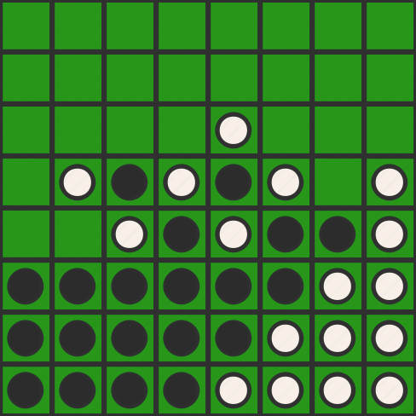
turn: 33 player: Black move: 61

Slide 36
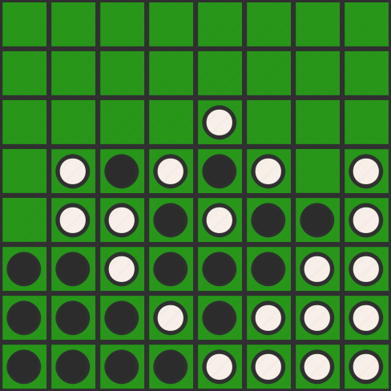
turn: 34 player: White move: 52

Slide 37
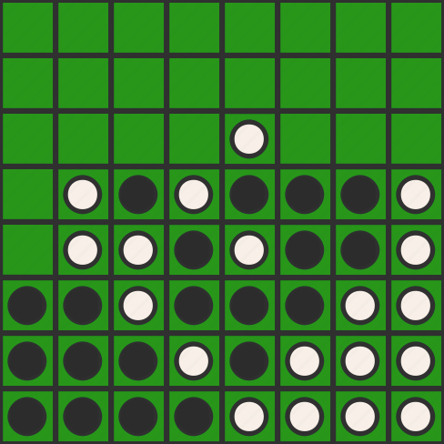
turn: 35 player: Black move: 47

Slide 38
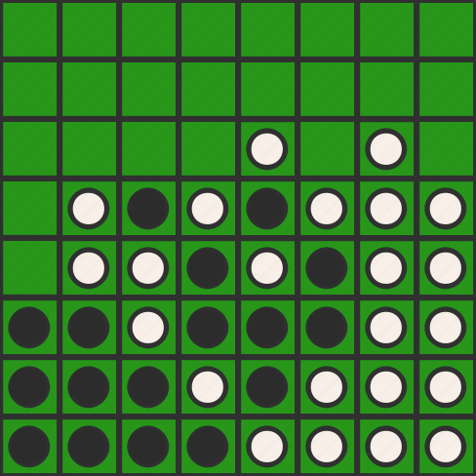
turn: 36 player: White move: 37

Slide 39
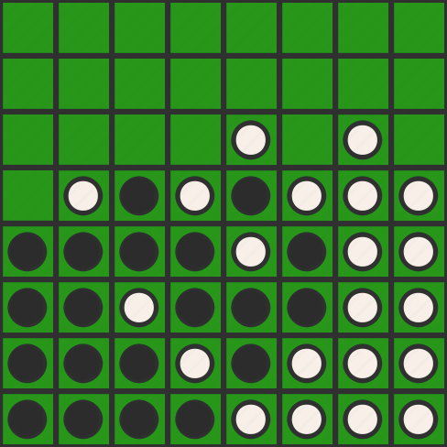
turn: 37 player: Black move: 51

Slide 40
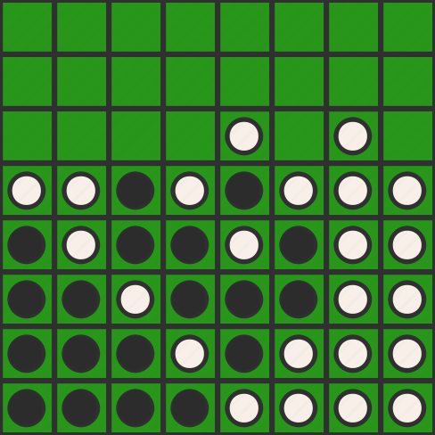
turn: 38 player: White move: 41

Slide 41
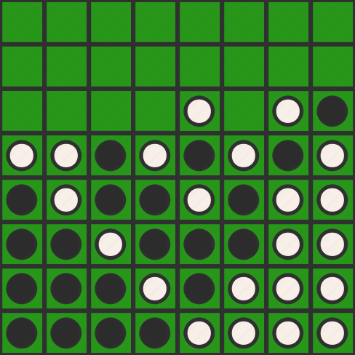
turn: 39 player: Black move: 38

Slide 42
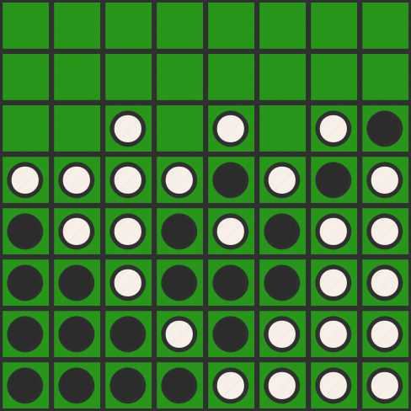
turn: 40 player: White move: 33

Slide 43
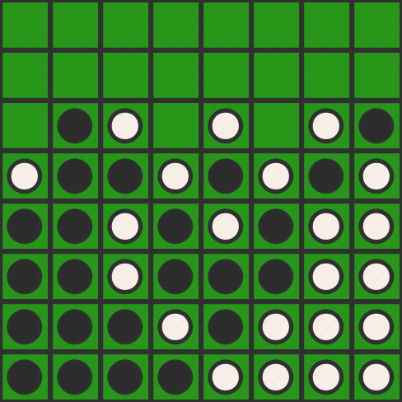
turn: 41 player: Black move: 32

Slide 44
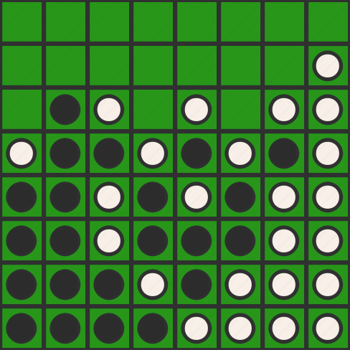
turn: 42 player: White move: 28

Slide 45
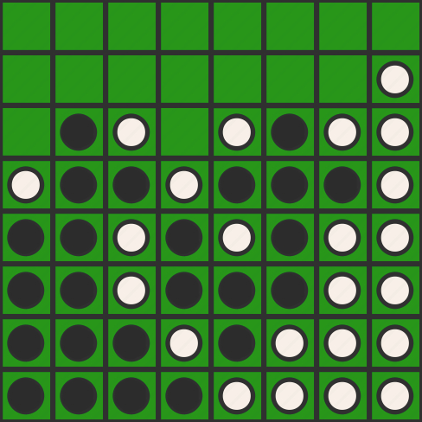
turn: 43 player: Black move: 36

Slide 46
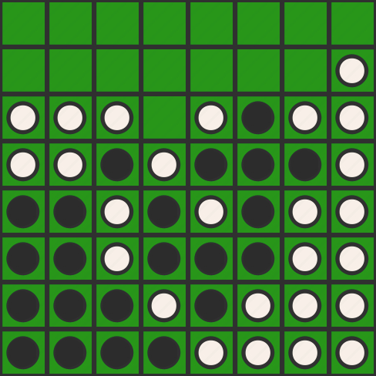
turn: 44 player: White move: 31

Slide 47
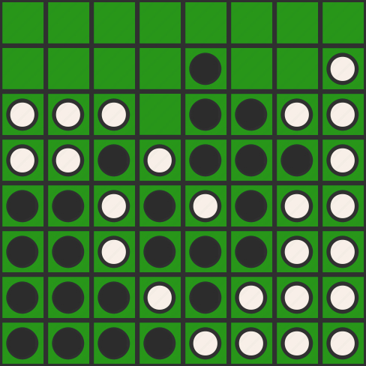
turn: 45 player: Black move: 25

Slide 48
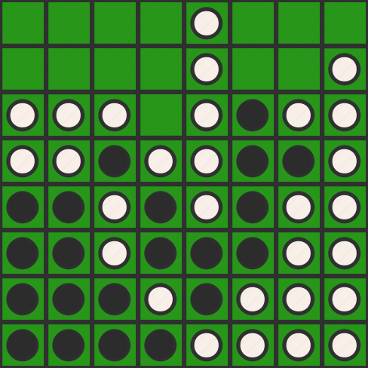
turn: 46 player: White move: 15

Slide 49
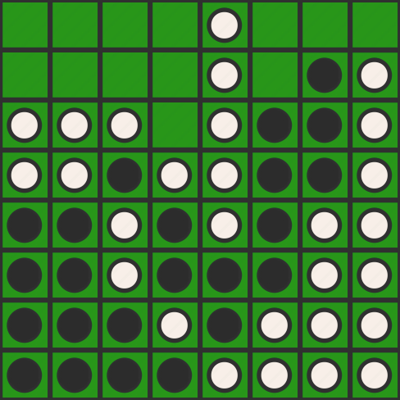
turn: 47 player: Black move: 27

Slide 50
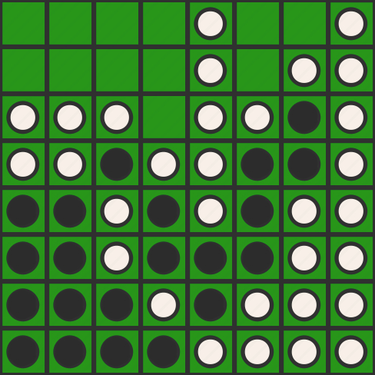
turn: 48 player: White move: 18

Slide 51
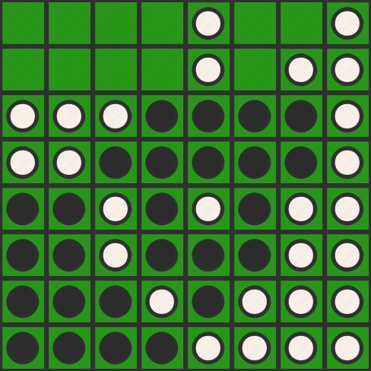
turn: 49 player: Black move: 34

Slide 52

turn: 50 player: White move: 26

Slide 53

turn: 51 player: Black move: 24

Slide 54

turn: 52 player: White move: 23

Slide 55

turn: 53 player: Black move: 22

Slide 56

turn: 54 player: White move: 11

Slide 57

turn: 55 player: Black move: 21

Slide 58
turn: 56 player: White move: None

Slide 59

turn: 57 player: Black move: 13

Slide 60

turn: 58 player: White move: 12

Slide 61

turn: 59 player: Black move: 16

Slide 62

turn: 60 player: White move: 17

Slide 63

turn: 61 player: Black move: 14

Slide 64
turn: 62 player: White move: None

